Slide 1
Co-resonating activity systems: The transformative potential of teachers’ and students’ inquiry-based learning for local communities
Megumi Asakura
Kansai University Graduate School of Letters

Slide 2
Research purpose and background
The Philosophy of Japan's Curriculum Guidelines
A Curriculum Open to Society
But……
Why can't a curriculum open to society be realized?

Slide 3

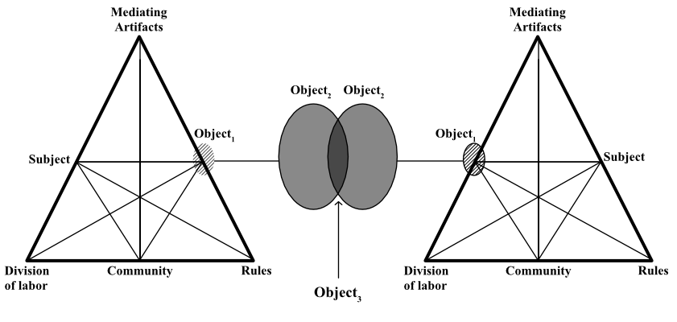
Research purpose and background
School
Education
True feelings…
Subject Acquisition
Exam Preparation
True feelings…
Learner’s Agency
Enjoy Learning
Social
Education
Lifelong
Education
Club
Activity
(Bukatsu)
This figure is based on the data from Y.Engeström,2001

Slide 4
Research purpose and background
Perspective
Period for inquiry-based cross-disciplinary study of high school. (SOUTAN)
Analysis of the interview with teacher A.
“Teachers' Inquiry” and “Students' Inquiry” resonate, transforming the community’s activity system.
Concept of Co-resonating Activity Systems.

Slide 5
What is SOUTAN?
Period for integrated studies → Period for inquiry-based cross-disciplinary study.
There are no specialized instructors under the licensing system.
The number of credits can be set within a range, allowing each department considerable discretion.
Curriculum management across the entire high school and collaboration beyond subject boundaries are essential.

Slide 6
What is SOUTAN?
Issues
Insufficient teaching experience
Limited financial support
Teaching focused excessively on exam preparation and careea guidance
Insufficient class time
The spread of the COVID-19
Many schools rely on curricula provided by the education industry, and teachers themselves lack sufficient engagement in inquiry-based educational activities.
Tanaka, K. 2022. “Challenges and Current Status of Curriculum Developmentin High School “Period for inquiry-based cross-disciplinary study.”
Sousei Journal Human and Society 5: 92-100. accessed 2025-11-9.

Slide 7
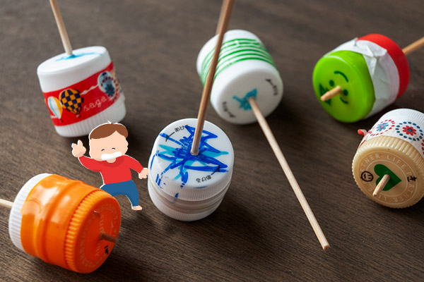
Teacher A's Educational Philosophy and Background
Teacher A's Narrative
There was an excessive number of plastic bottle trash, so we made plastic bottle tops. The kids had a blast, and hundreds showed up, but people from other booths told us, "You guys were so focused on making tops you didn't talk about the trash problem at all. " Turns out we really were just scrambling to handle everything. [...] But when they went to university, everyone said, "We don't know about inquiry-based learning." [...] So they tried doing the same process together for a whole year. [...] So now, they wash the stuff they collect themselves, turn it into photo frame art, run workshops about thinking about trash, and are starting to monetize it. [...] And what this person has done so far is that every time they crossed a boundary, what started as just an activity or just a whim gradually deepened and gradually became a question. It started as just an activity, but it gradually became a question. So it doesn't have to be a question from the start. It started with that feeling of, "What a dump!"
- Just an activity
Reference: tops made from plastic bottle caps
https://news.infoseek.co.jp/article/womanexcite_E1545054738222/

Slide 8
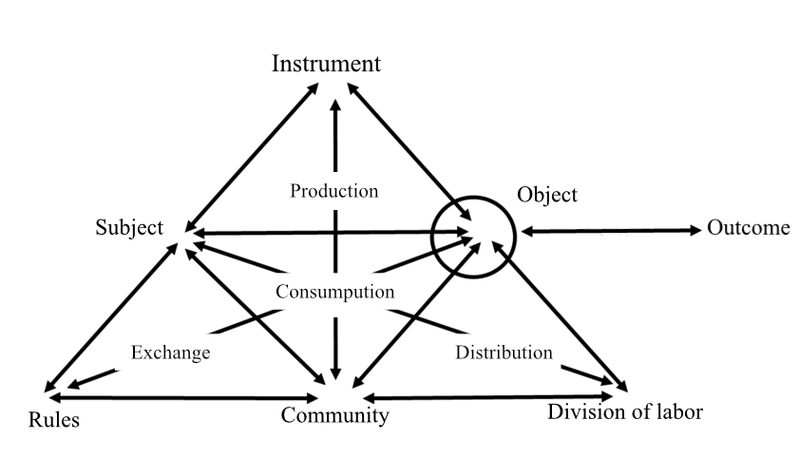
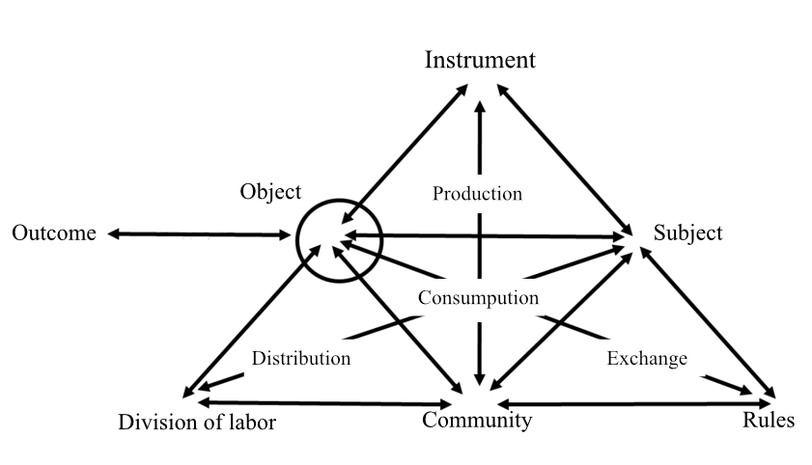
Teacher A's Educational Philosophy and Background
High School SOUTAN’s
Issues
Teaching tool
Correct answer
Relation to subject Knowledge and mastery
Exam preparation
Everyone has reached the minimum standard
Just an activity
and
Latent inquiry
Student
Lack of
ownership
Teacher
Teacher’s Management
Outcome
Local issues as
inquiry subjects
School rules
Employment rules
Not cause trouble
Classroom
Teacher’s Meeting
Subject-specific expertise

Slide 9
Teacher A's Educational Philosophy and Background
Teather A’s
Self- exploration
Production capabilities
Empowerment
personal matter
Teacher A’s own goal revision
Music producer → High school teacher
Highly exchangeable “someone”
Highly usable “someone who isn't yet anyone”
Teacher A
herself
Teacher A
Financial stability
Turn her passion into her career
The music she likes
The music that sells
Graduating from university
The necessity of labor
Musical peers
School
Company
Music production
Music sales
Branding

Slide 10
Practical Case Study of Teacher A
Inquiry Colloquium (in Japanese 探究懇話会：Tankyu Konwakai)
Boundary-Crossing Support for Students' Inquiry Activities Outside the School Setting
Fostering the Teacher Mindset for Accompaniment Support
personal matter
Inquiry
Colloquium
Local
Community
member
Researcher
Social Issues
Teacher
Student

Slide 11
Practical Case Study of Teacher A
Student Outcomes Reflected in Teacher A's Narrative
A student who had aspired to become a nurse switched to applying to a university specializing in regional policy studies
Participating in activities exploring ways to revitalize neighborhood associations
Before the Activity
She thought she wanted to learn about the elderly in order to become a nurse.
She understood that cooperation with neighborhood association activities was volunteer work.
During the Activity
Her self-esteem increased as she was appreciated by the elderly.
She learned that revitalizing neighborhood association activities is something the local government does as part of its job.
After the Activity
She found fulfillment in building community for local residents and, by her own decision, shifted her intended university path to a regional policy program to pursue it as her future career.

Slide 12
Co-resonating Activity Systems and Knotworking
Knotworking is a collaborative performance in the field of practice, resembling an 'improvised orchestration’.
Yamazumi (2008)
The individual's own activity system
To reflectively recognize the activity system that underlies one's existence and the self that is affected by that system
To resonate with the underlying activity systems of others through activity, and to make others resonate with one's own underlying activity system
The core motivation that creates the knots of knotworking

Slide 13
Co-resonating Activity Systems and Knotworking
Consept image: Co-resonating activity systems
Teacher A influenced students' career path changes through inquiry activities, leveraging her own experiences, and consequently deepened her confidence in her educational methodology as a result of those successful outcomes
Example of an Inquiry Colloquium
personal matter
Inquiry
Colloquium
Local
Community
member
Researcher
Social Issues
Teacher
Student

Slide 14
Co-resonating Activity Systems and Knotworking
Consept image: Co-resonating activity systems
Teacher A influenced students' career path changes through inquiry activities, leveraging her own experiences, and consequently deepened her confidence in her educational methodology as a result of those successful outcomes
Example of an Inquiry Colloquium
personal matter
Inquiry
Colloquium
Local
Community
member
Researcher
Social Issues
Teacher
Student

Slide 15
Co-resonating Activity Systems and Knotworking
Consept image: Co-resonating activity systems
Teacher A influenced students' career path changes through inquiry activities, leveraging her own experiences, and consequently deepened her confidence in her educational methodology as a result of those successful outcomes
Example of an Inquiry Colloquium
personal matter
Inquiry
Colloquium
Local
Community
member
Researcher
Social Issues
Teacher
Student

Slide 16
Co-resonating Activity Systems and Knotworking
Consept image: Co-resonating activity systems
Teacher A influenced students' career path changes through inquiry activities, leveraging her own experiences, and consequently deepened her confidence in her educational methodology as a result of those successful outcomes
Example of an Inquiry Colloquium
personal matter
Inquiry
Colloquium
Local
Community
member
Researcher
Social Issues
Teacher
Student

Slide 17
Co-resonating Activity Systems and Knotworking
Consept image: Co-resonating activity systems
Teacher A influenced students' career path changes through inquiry activities, leveraging her own experiences, and consequently deepened her confidence in her educational methodology as a result of those successful outcomes
Example of an Inquiry Colloquium
personal matter
Inquiry
Colloquium
Local
Community
member
Researcher
Social Issues
Teacher
Student

Slide 18
Co-resonating Activity Systems and Knotworking
Contradictions in Knotworking
Knotworking is not established spontaneously, without any preceding conditions, nor is it suddenly formed based on unilateral instruction or rigid rules
Relation to subject Knowledge and mastery
Exam preparation
Everyone has reached the minimum standard
Cost Reward
Exchange value
use value
potential
Just an activity
Latent inquiry
School Education
Social Education

Slide 19
Co-resonating Activity Systems and Knotworking
The Value of “Just an Activity"
The value of "Just an activity" is significant, starting with students becoming aware of their individual activity system, subsequently leading to the emergence of inquiry from their recognition of the dilemma between exchange value and use value
Exchange value
use value
Cost Reward
Relation to subject Knowledge and mastery
Exam preparation
Everyone has reached the minimum standard
potential
To recognize double binds
To internalize the issue
Student’s own activity system

Slide 20
Conclusion and Future Work
The resonance of activity systems empowers both students and teachers.
Knotworking based on the resonance of activity systems may generate a spearhead for the transition to Fourth Generation Activity Theory.
Activity system analysis that focusing on individuals' cultural-historical context is open to discussion.
Change Laboratory will examine whether this high school's SOUTAN can break through by overcoming the double bind between exchange value and use value.
The practice of teacher A as the spearhead of the high school’s SOTAN requires further analysis.

